Slide 1
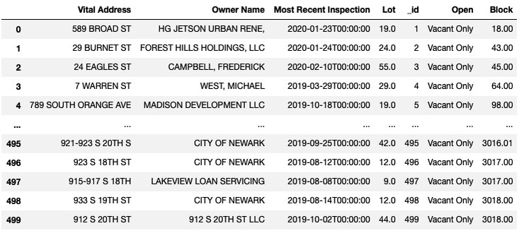
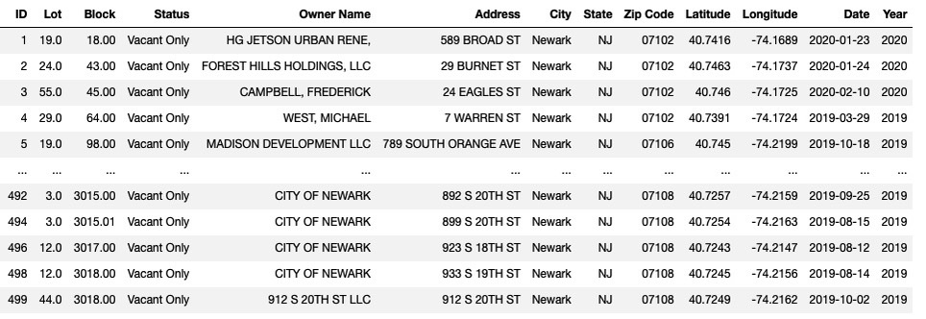
ABANDONED REAL PROPERTY IN THE CITY OF NEWARK
The City of Newark maintains an abandoned property list which is callable via API containing approximately 500 abandoned properties.
The data is contextual to Newark, NJ and in it’s retrieved state not compatible with data from other sources, for example these addresses are incomplete and not suitable for data analysis.
The data cleaning techniques employed convert the address list into usable data that is now compatible with various additional data sets for deeper analyses as we will see in this presentation with insignificant data loss.

Slide 2
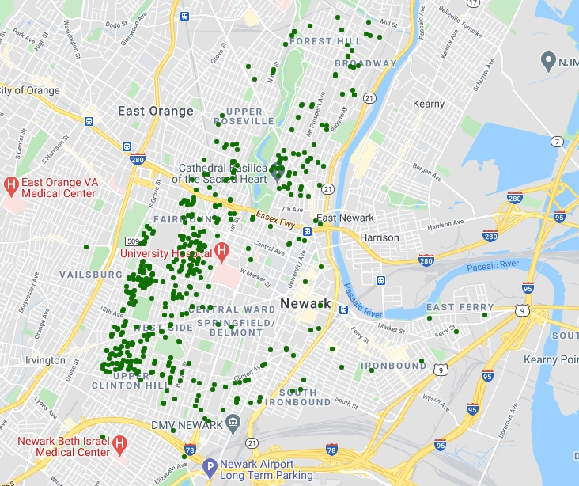
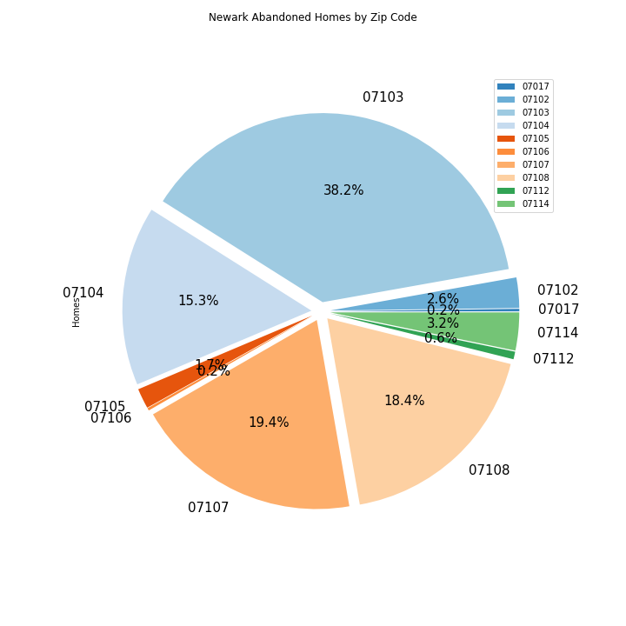
ABANDONED PROPERTY MAP

